Slide 1
Lesson objective
Title: Inverse thinking
Aim:
Calculate an unknown length using a given area of a shape
Plan:
Review P, A and Volume
  Creating limited A and P
Parallelograms
Inverse problems
Need whiteboards and calculators

Slide 2
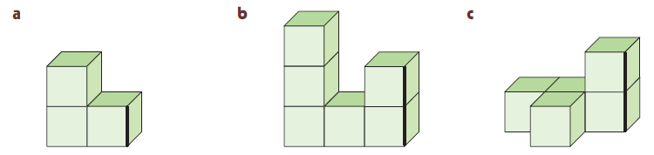
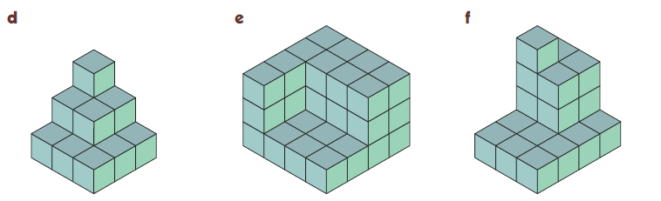
What is the volume of these shapes?
1
Count the cubes. Include ones you can’t see but that would form part of the shape
$$V=3{cm}^{3}$$
$$V=6{cm}^{3}$$
$$V=5{cm}^{3}$$
$$V=14{cm}^{3}$$
$$V=36{cm}^{3}$$
$$V=21{cm}^{3}$$

Slide 3
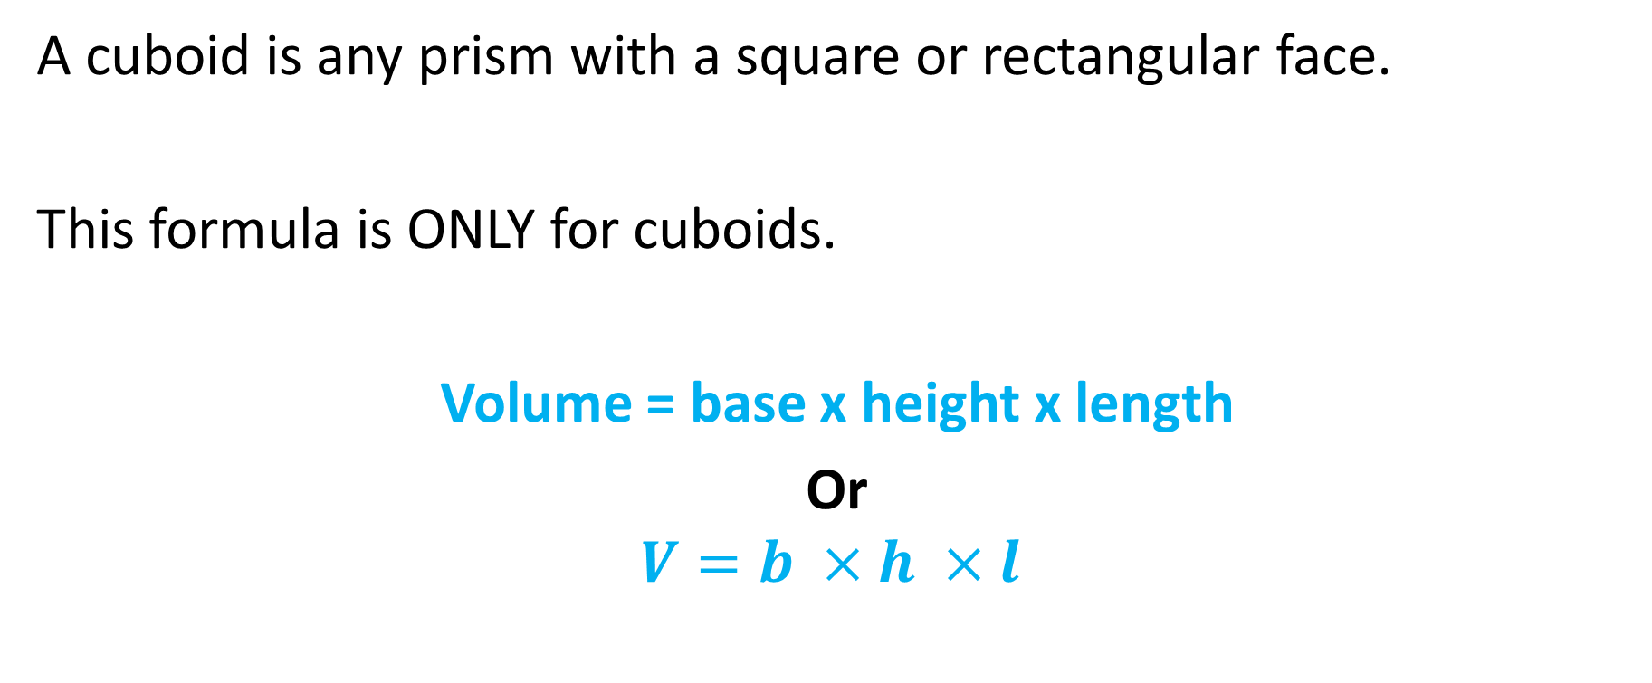
Rule for volume of cuboids
A cuboid is any prism with a square or rectangular face.
This formula is ONLY for cuboids.
Volume = base x height x length
Or
$$V=b ×h ×l$$

Slide 4
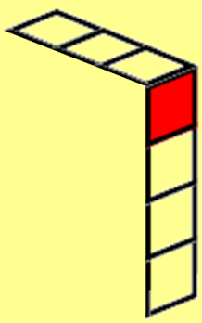
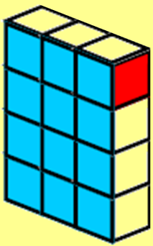
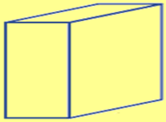

Volume of Rectangular Prisms
DIAGRAM
RULE
NUMBERS
SOLVE
1
Volume is measured in cubic units (e.g. cm³)
  Say “cubic centimetres” or “centimetres cubed”
Example: this shape’s volume is 12 cubic centimetres
    The larger shape is made of 6 shapes like the first one
    12 x 6 = 72 cubic centimetres
For any rectangular prism
$Volume=base×height×length$
1 cube = 1cm³
Write:
$$Volume=b×h×l$$
Height
$$V=3×4×6$$
Base
Length
$$V=72{cm}^{3}$$
D
$$V=b×h×l$$
R
$$V=4×3×2$$
N
$$V=24{cm}^{3}$$
S
Show 4-step working for each question

Slide 5
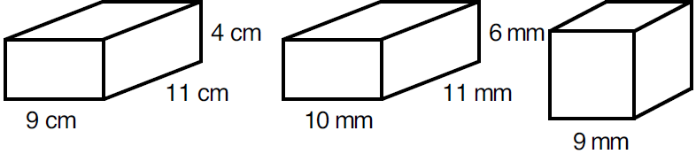
Find the volume of these rectangular prisms?
2
DIAGRAM
RULE
NUMBERS
SOLVE
$$V=b×h×l$$
$$V=9×4×11$$
$$V=396{cm}^{3}$$
$$V=b×h×l$$
$$V=10×6×11$$
$$V=660{mm}^{3}$$
Don’t times them all, just the
Base
Height
Length
$$V=b×h×l$$
$$V=9×9×9$$
$$V=729{mm}^{3}$$

Slide 6
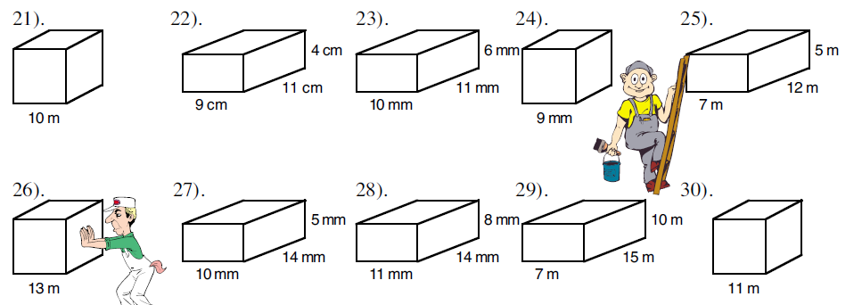
Volume Practice
DIAGRAM
RULE
NUMBERS
SOLVE

Slide 7
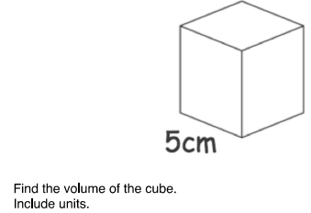
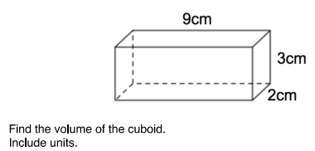
Volume

Slide 8
Whiteboards
3m
2m
15m
7m

Slide 9
Area of L blocks
16m
10m
5m
20m

Slide 10
Perimeter
The length forming the outside boundary of a shape.
12cm
9cm
8cm
7m
4cm
10cm
12cm
15m

Slide 11
Whiteboards
Calculate the perimeter.
8cm
11cm
10cm
5m
6cm
7cm
15cm
10m

Slide 12
Area
11cm
9cm
8cm
7m
4cm
10cm
12cm
15m

Slide 13
Whiteboards
Calculate the area.
6cm
7cm
6cm
7mm
2cm
8cm
10cm
10mm

Slide 14
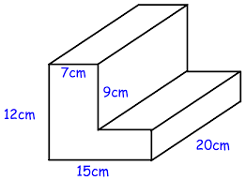
Whiteboards
Calculate volume:

Slide 15
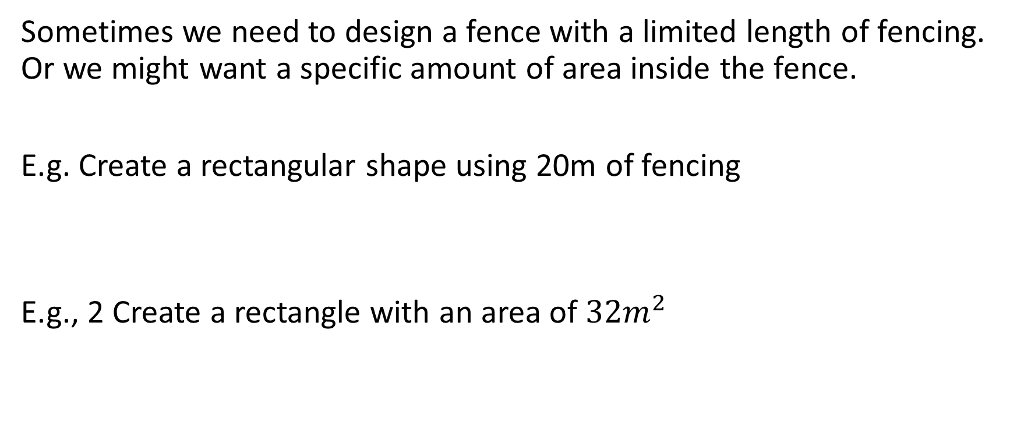
Creating Area and perimeter
Sometimes we need to design a fence with a limited length of fencing. Or we might want a specific amount of area inside the fence.
E.g. Create a rectangular shape using 20m of fencing
E.g., 2 Create a rectangle with an area of ${32m}^{2}$

Slide 16
Whiteboards
Create a rectangle with a perimeter of:
40m
16m
10m

Slide 17

Whiteboards
Create a rectangle or square with an area of:
${30m}^{2}$
${25m}^{2}$
${12m}^{2}$

Slide 18
Area of parallelograms
A = base x height
8cm
10cm

Slide 19
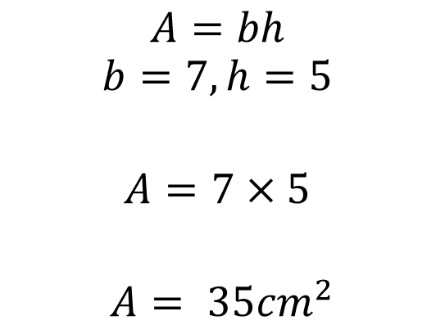
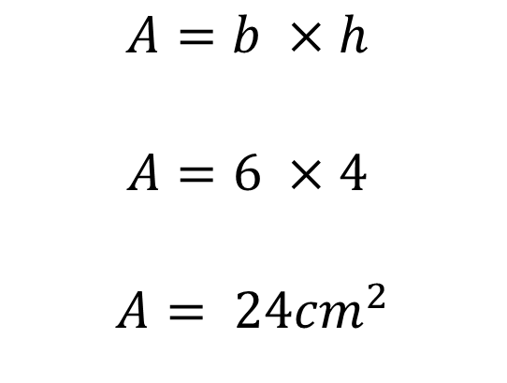
I do
4cm
6cm
$$A=b ×h$$
$$A=6 ×4$$
$$A= {24cm}^{2}$$
$$A=bh$$
$$b=7, h=5$$
$$A=7×5$$
$$A= {35cm}^{2}$$

Slide 20


We do
5cm
10cm
$$A=b ×h$$
$$A=$$
$$A=$$
$$b=11, h=6$$
$$A=$$
$$A=$$

Slide 21

You do
3cm
8cm
$$A=b ×h$$
$$A=$$
$$A=$$
$$b=12, h=5$$
$$A=$$
$$A=$$

Slide 22
Inverse
Solve the missing blanks (on your whiteboards)
5 x ____ = 25
3 x ____ = 18
10 x ____ = 100

Slide 23


Inverse problems
Tom knows his lawn is ${32m}^{2}$. He also knows it is rectangular is shape and 8m long. How wide is Tom’s lawn?
8m
? m
$${32m}^{2}$$

Slide 24


Inverse triangles
How can we find the height of this triangle?
Area formula:
$$A=b ×h ÷2$$
$$A=20 × ? ÷2=50$$
$$h= ?$$
$${50m}^{2}$$
20m

Slide 25



Inverse
Sketch these triangles and label, then solve the height of these triangles (exercise books).
$${20m}^{2}$$
$${100m}^{2}$$
$${10m}^{2}$$
8m
5m
10m

Slide 26
Textbook practice
Page 469
Questions 1 - 9

